Slide 1
AE4233 Advanced Design Methodologies
MDO practical 1
Airfoil fitting with CST
D.Steenhuizen@tudelf.nl
A.Elham@tudelft.nl
G.LaRocca@tudelft.nl

Slide 2
Today’s topics
Overview of Fmincon’s usage in Matlab
Interactive demonstration of simple optimizations
Quick refresher CST-method
Assignment: fit existing airfoils with CST-method

Slide 3
Today’s topics
Overview of Fmincon’s usage in Matlab
Interactive demonstration of simple optimizations
Quick refresher CST-method
Assignment: fit existing airfoils with CST-method

Slide 4
Today’s topics
Overview of Fmincon’s usage in Matlab
Interactive demonstration of simple optimizations
Quick refresher CST-method
Assignment: fit existing airfoils with CST-method

Slide 5
Demo optimization
Please download the files Constrained.m and Unconstrained.m from Blackboard

Slide 6
Overview of Fmincon’s usage in Matlab
Interactive demonstration of simple optimizations
Quick refresher CST-method
Assignment: fit existing airfoils with CST-method

Slide 7
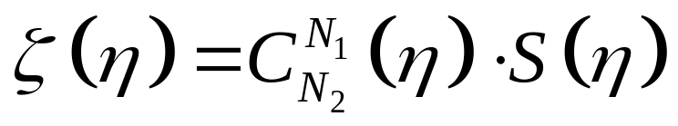
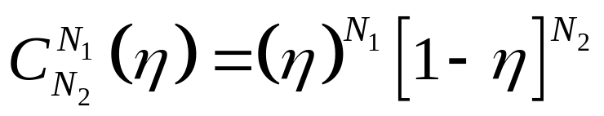
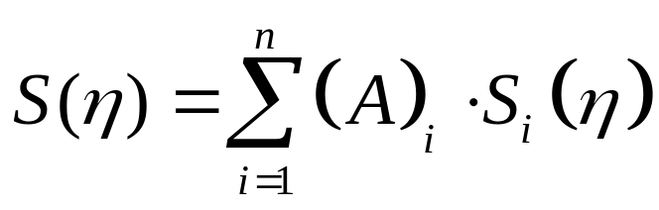
CST method: mathematical foundation

Slide 8
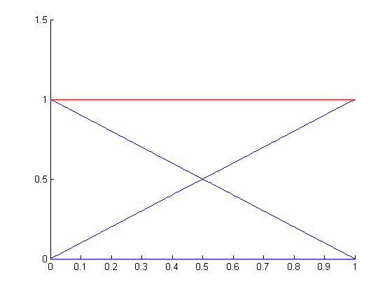
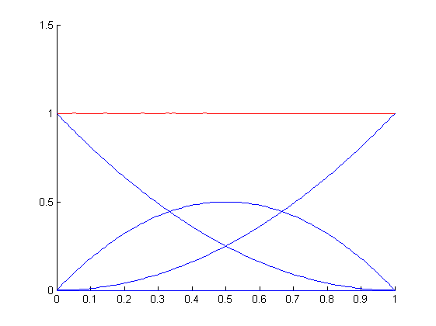
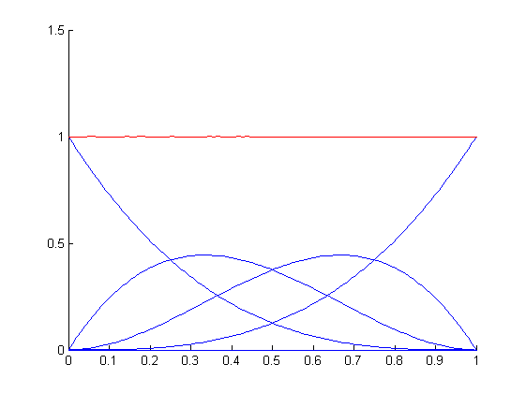
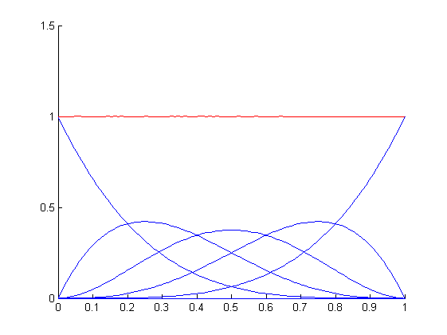
Shape function: Bernstein polynomials
A = [1 1]
A = [1 1 1]
A = [1 1 1 1]
A = [1 1 1 1 1]
All scaling factors A equal to one. Whatever the order of the polynomials, the sum is always 1

Slide 9
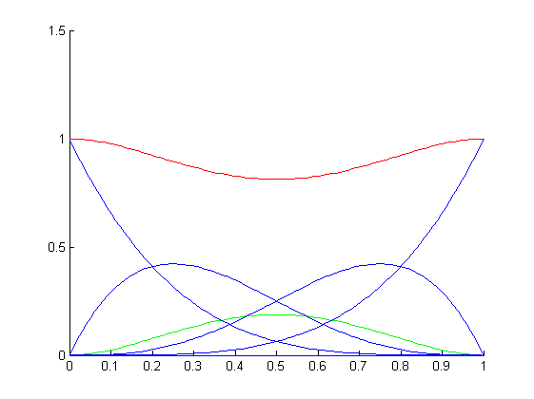
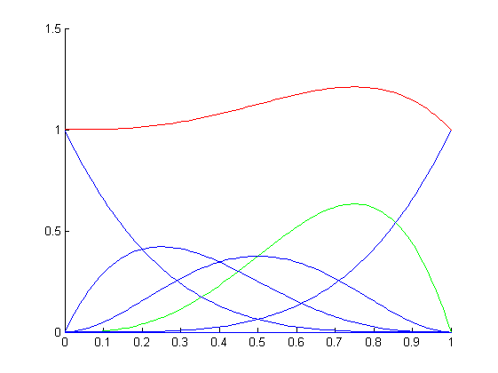
Bernstein polynomials
A = [1 1 0.5 1 1]
A = [1 1 1 1 1]
A = [1 1 1 1.5 1]
Effect of changing scaling factor

Slide 10
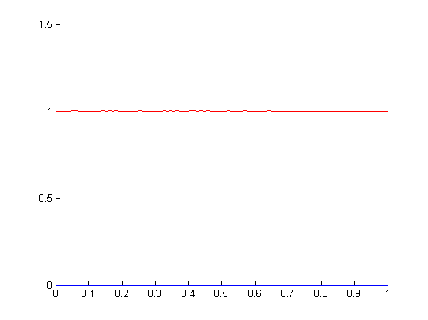
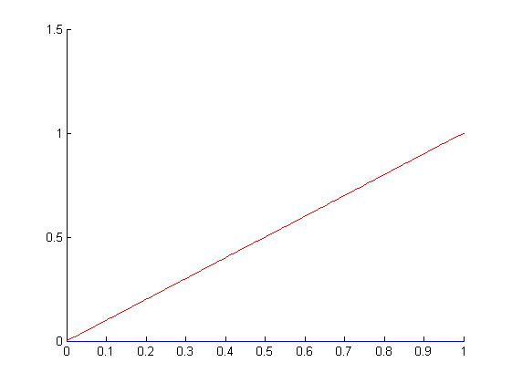
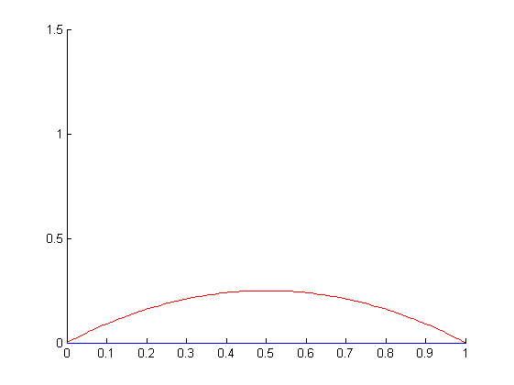
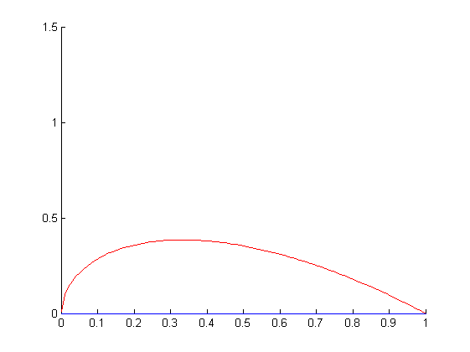
Class Functions
N₁=0 , N₂=0
N₁=1 , N₂=0
N₁=1 , N₂=1
N₁=0.5 , N₂=1

Slide 11
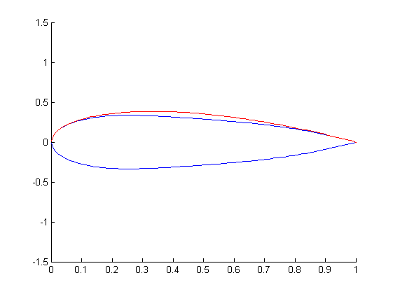
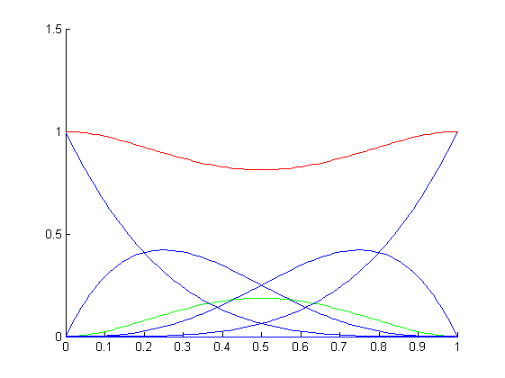
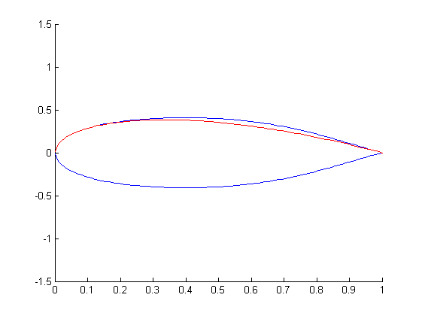
The CST transformation Method in action
=
X
=
X

Slide 12
Overview of Fmincon’s usage in Matlab
Interactive demonstration of simple optimizations
Quick refresher CST-method
Assignment: fit existing airfoils with CST-method

Slide 13
Assignment: fit an airfoil with the CST method
We want to “fit” two existing airfoils with the CST-method, i.e. find the CST representation that best matches the original airfoil coordinates.
Please download the files e553.dat and withcomb135.dat from BlackBoard
These files contain coordinates for a low subsonic airfoil (e553) and for a super-critical one (withcomb135)

Slide 14
Assignment: fit an airfoil with the CST method
For the fitting of these airfoils, an optimization must be elaborated that minimizes the “error” between the CST-airfoil and the original coordinates.
Can you think of a useful objective function for this problem?

Slide 15
Assignment: start by writing down the problem
Before any programming, please give a formal specification of the optimization in the correct format:
  Objective function
  Design vector
  (in)equality constraints
  Bounds

Slide 16
Assignment: normalization
In an optimization problem, large differences in magnitude of design variables, objective and constraint values can occur.
Because of finite machine accuracy, a large difference in magnitude can cause inaccuracies and protract the solution time.
Therefore, it is common practice to normalize all variables, objective and constraint functions w.r.t. a reference (or initial) condition.

Slide 17
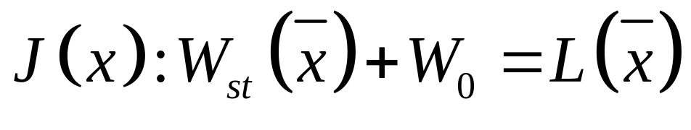
Assignment: normalization example

Slide 18
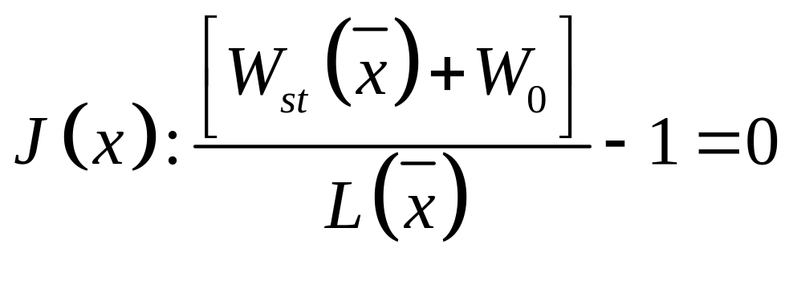
Assignment: normalization example

Slide 19
Assignment 1
Work out this optimization problem in MatLab for both the e553 and the withcomb135 airfoils.
Make use of the provided 2D CST Matlab-function D_airfoil2.m, found on BlackBoard.

Slide 20
Assignment; questions
Answer the following questions:
  What is the optimal design vector?
  How is the optimizes objective value improving when the order of polynomials increases?
  How does the time to converge change?
  What is the difference in the order of polynomials required to fit the withcom135 airfoil with the same error measured for the e553 airfoil?
  What is the difference in result when different initial points are used? (if none, why?)
  Can you plot the objective function history to visualize whether you actually reached a global optimum? (if no, why?)

Slide 21
Assignment 2
Work out this optimization problem in MatLab for both the biere_turbine_sharp and the biere_turbine_sharp airfoils.
Again, make use of the provided 2D CST Matlab-function D_airfoil2.m, found on BlackBoard.
Change the parameters of the Class-function, investigate if this can improve the fit quality.
Try to adjust the objective function such that results in the best fit of the airfoils.

